Slide 1
Project Team ID: PTID-CDA-AUG-24-200
Team Members:
Darshan N: darshan.1O14@gmail.com
Sanjana PR: prsanjana92O@gmail.com
Rahul Gudiboina : rahulgudiboina@gmail.com
First Capstone Project CDA

Slide 2

PROFIT ANALYSIS

Slide 3
Perform Regression Analysis for the given data to identify how the money spent on Marketing, R&D, and Administration is affecting the company’s Profit. Predict the Profit for the below-given input features.
R&D Spending | Administration | Marketing Spending | Predicted Profit
21892.92 | 81910.77 | 164270.7 | 70037.9
23940.93 | 96489.63 | 137001.1 | 70554.57

Slide 4
TOPIC : PROFIT ANALYIS
Attribute Information:
R&D spending: The amount which startups are spending on Research and development.
Administration spending: The amount which startups are spending on the admin panel.
Marketing spending: The amount which startups are spending on marketing strategies.
State: To which state that particular startup belongs.
Profit: How much profit that particular startup is making.

Slide 5
Profit Analysis
TOPIC : PROFIT ANALYIS
Visualize the data using Tableau /PowerBI and derive insights about all the features provided and give your inputs/suggestions to the company.

Slide 6
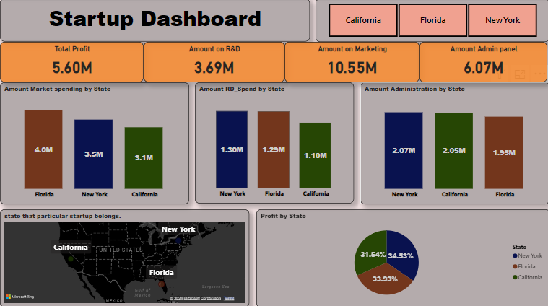

Slide 7
Analyzing the Startup Dashboard
OVERVIEW:
The dashboard provides a thorough summary of the financial success of a startup in three different states: Florida, New York, and California. Important parameters including total profit, R&D expenditures, marketing costs, and administrative charges are included.
Overall performance:
Profitability: The startup generated a total profit of $5.6 million, with a significant portion allocated to R&D ($3.69 million) and marketing ($10.55 million).
State-Wise Performance: New York leads in profit (34.53%), followed by California (33.93%) and Florida (31.54%).

Slide 8
Conclusions from Amount Market Spending by State
Based on the provided data, here are some key conclusions about the amount market spending by state:
Florida has the highest market spending: Among the three states, Florida has allocated the most to marketing efforts. This could indicate a more aggressive marketing strategy or a focus on a larger market share in that state.
New York and California have similar spending: New York and California have relatively similar levels of market spending. This might suggest a competitive market dynamic or a balanced approach to marketing across these states.
California has the lowest spending: California, despite beingti a significant market, has the lowest market spending among the three states. This could be attributed to various factors, such as a different marketing strategy, lower perceived market potential, or a focus on other growth areas.

Slide 9
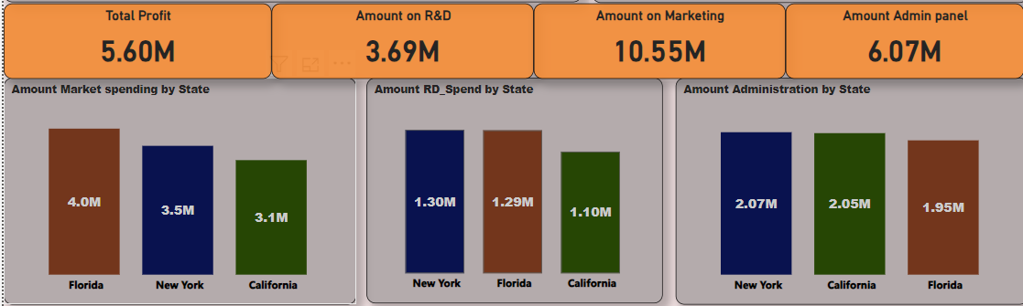
Analyzing R&D Spending by State
Key Observations:
New York Dominates: New York has the highest R&D spending among the three states, indicating a strong focus on innovation and product development.
Florida and California: Florida and California have similar R&D spending, with California slightly exceeding Florida.

Slide 10
Analyzing Amount Administrative by State
Key Observations:
New York: The state of New York has the highest administrative costs, with a total of $2.07 million. This could be attributed to various factors, such as higher operating costs, a larger workforce, or more complex administrative processes.
California and Florida: Both California and Florida have similar administrative costs, with California slightly higher at $2.05 million and Florida at $1.95 million

Slide 11
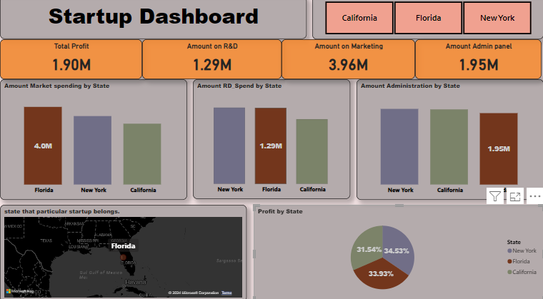
Profit by a particular Startup
Key Observations:To summarize, for the New York startup, the total profit is $1.93M with the following spends:
R&D: $1.30M
Marketing: $3.49M
Admin: $2.07M
This dashboard shows that the New York startup is spending the most on Marketing, followed by Administration, and then R&D. Notably, the high spending on Marketing suggests a significant investment in growth and customer acquisition, while Administration and R&D also receive substantial attention.

Slide 12
Conclusion:
The dashboard highlights a well-rounded approach to managing resources, with a strong emphasis on Marketing to drive growth, complemented by substantial investments in R&D and Administration. The profit distribution across states indicates that all regions are contributing significantly to the startup's success, with New York leading slightly. This balanced and strategic allocation of resources suggests that the startup is well-positioned for continued growth and operational stability across all its markets.

